Slide 1
Notes:
PowerPoint is gradually developing a really bad reputation. In some corners of industry, PowerPoint’s weaknesses have created a backlash against its use in the workplace. To illustrate this backlash and the tool’s drawbacks that caused it, I want to tell a story.

Slide 2
SAINT LOUIS PMI
Notes:
https://support.office.com/en-us/article/morph-transition-tips-and-tricks-bc7f48ff-f152-4ee8-9081-d3121788024f

Slide 3
MINUTIA SPOILS
Notes:
https://support.office.com/en-us/article/morph-transition-tips-and-tricks-bc7f48ff-f152-4ee8-9081-d3121788024f
Also Initial Possum, and Pianos Stimuli

Slide 4
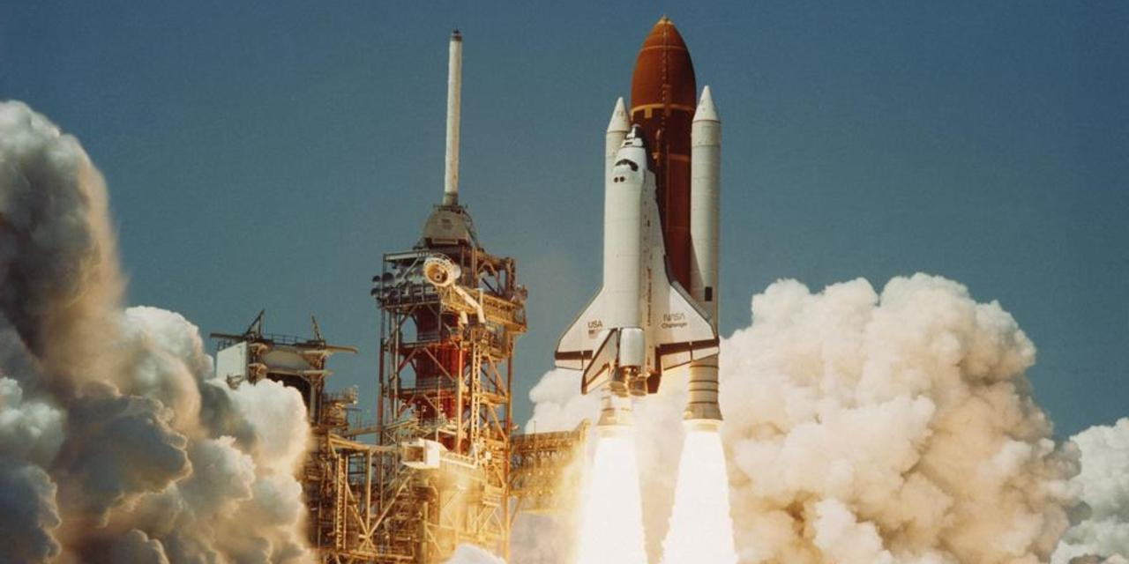
Notes:
On January 16, 2003, the Space Shuttle Columbia launched from Kennedy Space Center for a fifteen day mission. All indications from the ground and the shuttle showed that the lift-off was a textbook success.
Photo credit: Nasa.gov. Retrieved from http://www.bbc.com/future/story/20150130-what-caused-the-columbia-disaster

Slide 5
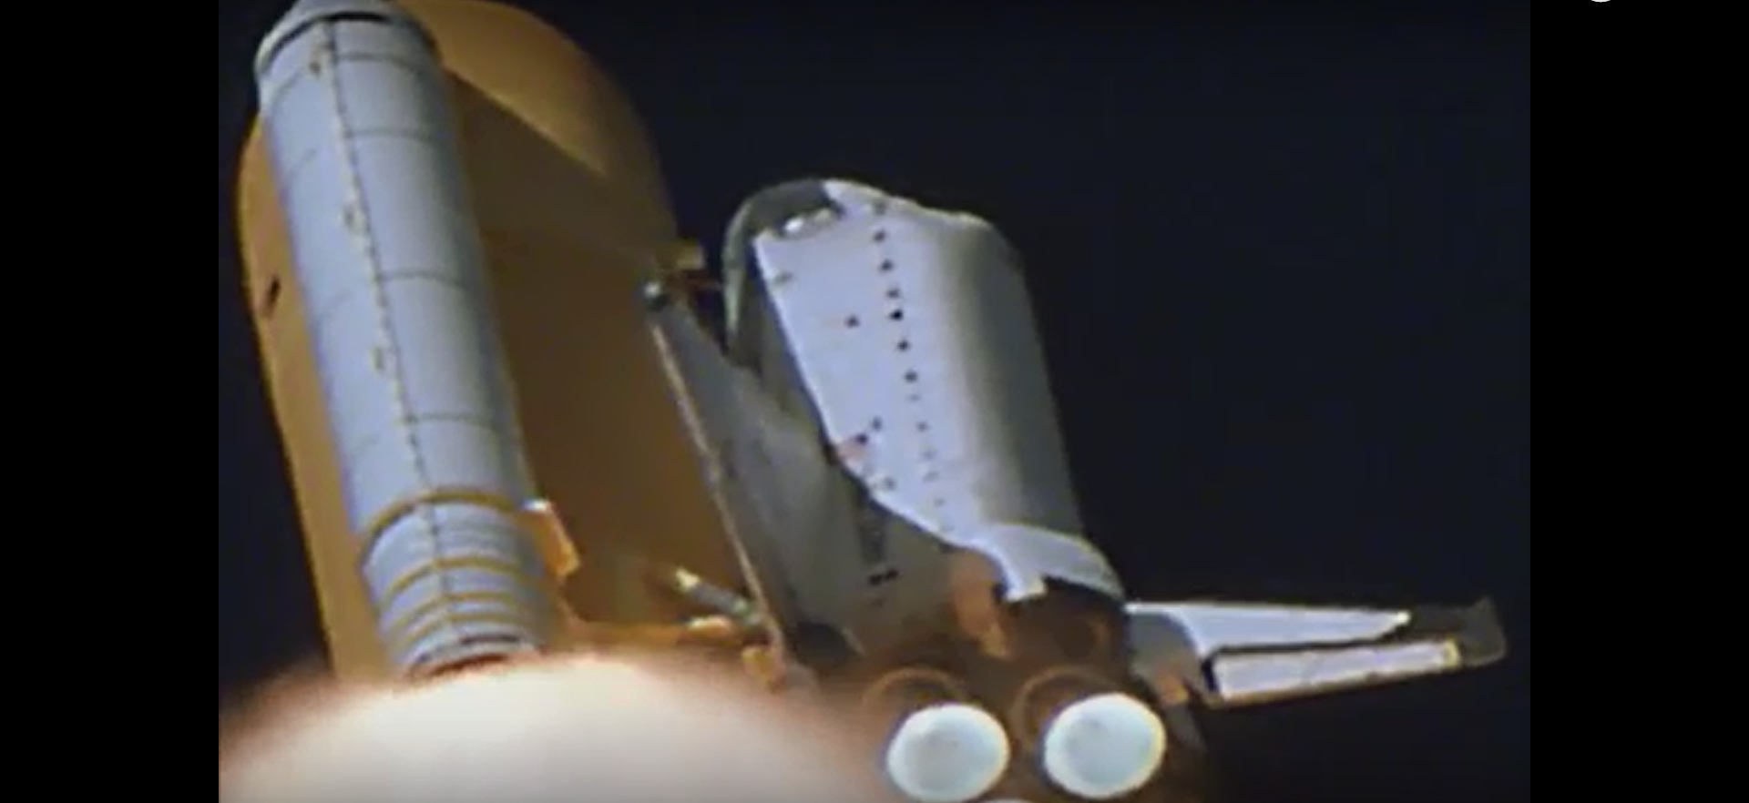
Notes:
A high resolution film recording of the launch was developed overnight and reviewed the next day. The film showed that, eighty seconds into the launch, a piece of foam insulation broke off from the external fuel tank and collided with the shuttle’s left wing. NASA asked Boeing to investigate the foam strike and brief them about any potential danger to the mission. Boeing prepared several PowerPoint slides and briefed the NASA mission managers. During these briefings, management consensus concluded that notable wing damage from a foam strike was highly unlikely, so the mission proceeded as planned.
In actuality, the foam strike had punched a hole in the tiles protecting the left wing’s leading edge. Fourteen days later, the shuttle reentered the Earth’s atmosphere. Compression of atmospheric air caused by the shuttle’s supersonic speed heated the outside gases to over two thousand degrees Fahrenheit. While these temperatures are normal for a shuttle reentry, some of the heat seeped into the inside of the wing through the hole in the damaged tile. Over the next several minutes, the left wing melted and fragmented from the inside, eventually tearing off from the fuselage and sending the shuttle into a violent spin. With all of its unprotected surfaces exposed to the heat of reentry, the shuttle disintegrated in the atmosphere. All seven astronauts were killed, and debris scattered over parts of Arkansas, Texas and Louisiana.
Video Image credit: Nasa.gov. Retrieved from https://www.youtube.com/watch?v=IgQ3ekcvyRA&t=103s

Slide 6
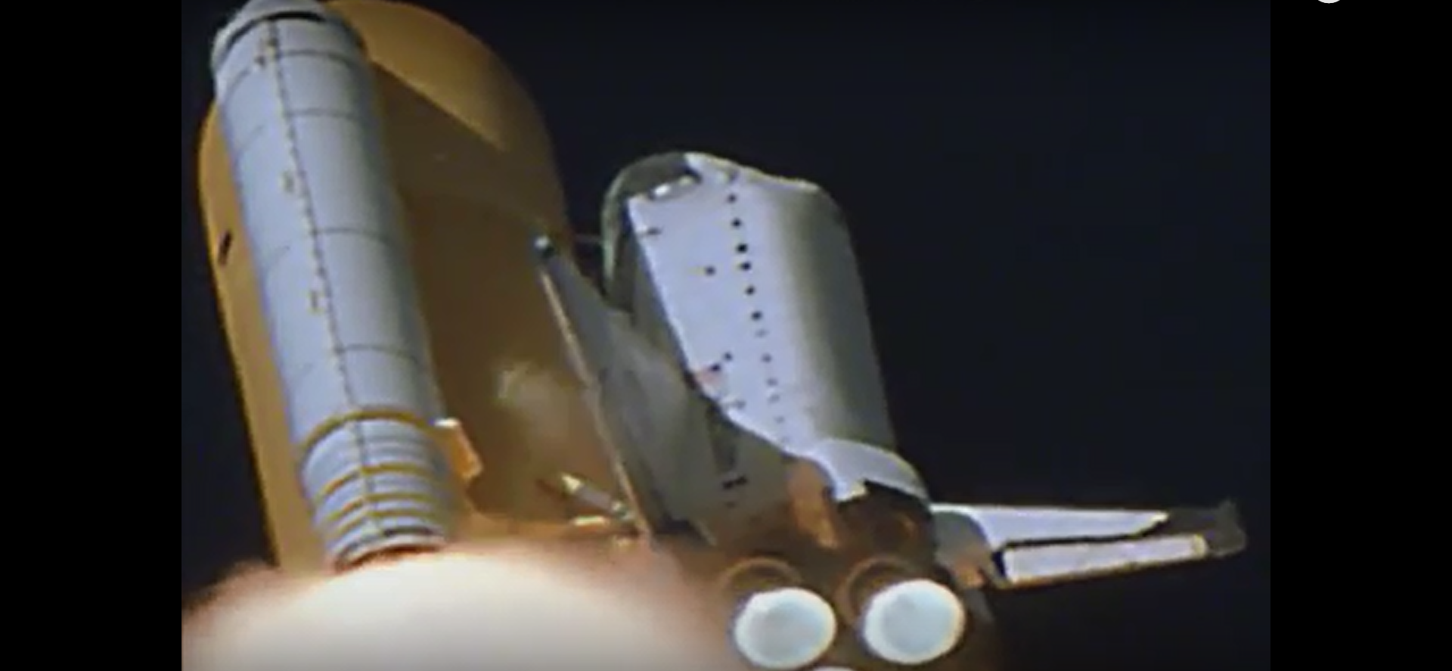
Notes:
The space shuttle program was suspended for two years, and a congressional investigation board (the Columbia Accident Investigation Board [CAIB]) was created to determine the cause of the disaster. Through interviews, review of documentation and emails, and conducting its own tests, the CAIB confirmed that the foam insulation strike damaged the left wing, causing the loss of the orbiter upon reentry.
The CAIB also determined that NASA’s ineffective use of PowerPoint was a contributing factor in the decision-making and risk-assessment that led to the accident.
“The Board views the endemic use of PowerPoint briefing slides instead of technical papers as an illustration of the problematic methods of technical com­munication at NASA.”
Video Image credit: Nasa.gov. Retrieved from https://www.youtube.com/watch?v=IgQ3ekcvyRA&t=103s

Slide 7
Notes:
This slide demonstrates how PowerPoint was used ineffectively, as analyzed by information design expert Edward Tufte. The title implies that it is the most important information on the slide, thereby dismissing the important contradictory information farther down. The title essentially means “we don’t think the wing was damaged” but other items on the slide imply “the wing could very well be damaged.”
The layout of slide bullet points gives a false indication of importance. The title gives a (false) conclusion, and the first large bullet provides information about data analysis. But the important items describing risk (it is possible [to damage the wing] at sufficient mass and velocity) and consequence (SOFI [spray-on foam insulation] can cause significant damage) are relegated to small font, several spots down, and four levels into the bullet hierarchy.
Because slides often use multiple bullets of text, which indent farther and farther with each level, presenters are incentivized to abbreviate, summarize, and omit important information so that a topic fits on one slide. This leads to overuse of acronyms and words like ”it,” “significant” and “significantly” instead of including detailed data.
Figure credit: CAIB. Retrieved from https://www.nasa.gov/columbia/home/CAIB_Vol1.html

Slide 8
1920 in³

Slide 9
Notes:
Arguably the most important information on the slide is the last bullet. It is listed last, three levels in, with a small font relative to other items on the slide. It explains that the test data, upon which all the optimistic conclusions about tile damage were based, only considered SOFI particles up to 3 in³. The actual piece of foam insulation that struck the wing was about the size of a briefcase, 640 times larger than the largest piece of test data.

Slide 10
Notes:
Amazon CEO Jeff Bezos has banned PowerPoint in meetings with his senior leadership team. Instead, meeting topics are described in a 4-6 page memo, and the meeting attendees start the meeting silently reading the memo for the first 20 minutes. Then, discussion, debate, and brainstorming can take place. “PowerPoint-style presentations somehow give permission to gloss over ideas, flatten out any sense of relative importance, and ignore the interconnectedness of ideas,” Bezos wrote in a 2004 email to his employees.
Leaders in industry, government, and as we will see, academia, have identified weaknesses in the way people use PowerPoint to communicate. The goal of this document is to present techniques that people can use to become expert presenters with PowerPoint.
Photo credit: Getty Images. Retrieved from https://www.inc.com/jessica-stillman/this-is-number-1-sign-of-high-intelligence-according-to-jeff-bezos.html

Slide 11
Matt’s presentation principle #1
The best way to use PowerPoint is to NOT USE PowerPoint
Notes:
According to a 2014 survey conducted by the Harris Corporation, 70% of professionals say that presentation skills are critical for success in their careers. Being able to deliver presentations effectively is a rare and valuable skill. The skill can benefit our company by enhancing the trust and credibility of our consultants in our customer’s eyes. Acquiring better presentation skills also benefits our employees by adding to their skill set. Many people experience anxiety at the thought of speaking in public. Often, that fear is due to the fear of failure, such as failing to engage, interest, or persuade your audience. Being able to deliver an engaging, memorable, educational, persuasive and impressive presentation alleviates that stress by ensuring that every presentation is successful.
This document is divided into three sections, corresponding to three principles of presentation skills.
Matt’s presentation principle #1: The best way to use PowerPoint is to NOT USE PowerPoint. In many situations, PowerPoint is counterproductive. Only use PowerPoint when its use enhances the presentation.

Slide 12
Matt’s presentation principle #2
Presentations are presented
Documents are documented
Notes:
Matt’s presentation principle #2: Presentations are presented. Documents are documented. A technical document, report, white paper, or article should use Microsoft Word. A presentation is a speech, sometimes enhanced with visual aids. Using PowerPoint as both a visual aid and a document results in a file that is both a suboptimal presentation and a suboptimal document.

Slide 13
Matt’s presentation principle #3
The best way to give a good presentation is to give a good presentation
Notes:
Matt’s presentation principle #3: The best way to give a good presentation is to give a good presentation. Another way of expressing this principle is to say that it’s not about you (the speaker), it’s about them (the audience). Good presentations take hard work and creativity.

Slide 14
Principle #1
1
2
3
4
5
Introduction
Notes:
Matt’s presentation principle #1: The best way to use PowerPoint is to NOT USE PowerPoint.
The criticisms from the Columbia Accident Investigation Board, James Mattis, H. R. McMaster and Jeff Bezos are not really about the PowerPoint tool itself. Their critiques are about how and when the tool is used. This section addresses when PowerPoint should be used and, more importantly, when it should NOT be used.

Slide 15
Document
Presentation
Large group
Visual aids
Notes:
First, PowerPoint should not be used in place of documentation. This was the CAIB’s main complaint about NASA’s culture of technical communication. Complex concepts are best communicated using words, sentences, and paragraphs, in the form of a technical report, white paper, memo, or trade study.
Second, make sure that the purpose of the event is to have an actual presentation. A presentation is intended to persuade, inform, or entertain. Design discussions and brainstorming sessions are more successful using a flip chart and easel, or white board.
Third, PowerPoint is best used for a large audience. The definition of large is a matter of judgment, but if the audience is small enough to sit around a table and review a printed chart or diagram, PowerPoint is unnecessary and probably an impediment.
Finally, PowerPoint should only be used when the presentation is enhanced by the use of visual aids, viewable by every member of the audience. If those in the back of the room or to the side of the screen cannot see the slides, it may be best to talk through the information or provide hard copy handouts.
Photo credit: Western New Mexico University. Retrieved from https://wnmu.edu/events/federal-reserve-bank-presentation/

Slide 16
1
2
3
4
5
Principle #2
Notes:
Matt’s presentation principle #2: Presentations are presented. Documents are documented.

Slide 17
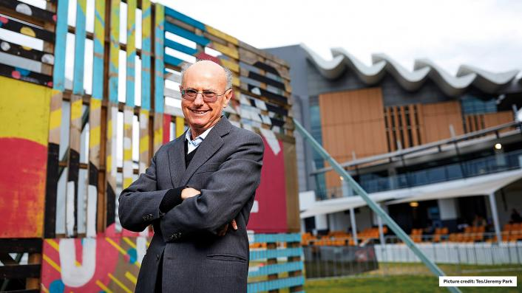
Notes:
Educational psychologist John Sweller developed the concept of cognitive load theory (CLT), which describes how people learn. CLT concepts apply to presentation skills because a presenter addressing an audience is attempting the same task as a teacher instructing students: to present information so that the audience receives, understands and remembers that information. CLT describes three kinds of cognitive load.
Photo credit: Tes / Jeremy Park. Retrieved from https://www.tes.com/news/tes-talks-john-sweller

Slide 18
Notes:
Photo credit: Matt Ingram

Slide 19
Working
Memory
Long-Term
Memory
Notes:
Information stays in working memory for about 10-15 seconds. Through encoding (the right-pointing arrow), that information gets stored to long-term memory, which essentially lasts throughout your life. Retrieval (the left-pointing arrow) allows that information to be retrieved whenever it is needed.

Slide 20
Notes:
Intrinsic load is the amount of working memory inherently required to learn a particular topic. Some topics have higher intrinsic load than others. For example, it is harder to learn how to perform brain surgery than to learn how to brew a perfect cup of tea. Brain surgery has higher intrinsic load than tea brewing.
For a perfect (or at least decent) cup of tea, see http://www.slate.com/articles/news_and_politics/fighting_words/2011/01/how_to_make_a_decent_cup_of_tea.html. You’re on your own for brain surgery.

Slide 21
Notes:
Germane load is the amount of working memory required to associate a topic with information already in long term memory. Germane load depends on the existing knowledge of the student. For example, if a person already knows how to drive a stick shift, that person can learn to ride a motorcycle more easily than a person who does not know how to drive a stick shift.

Slide 22
Notes:
Extraneous load is the amount of working memory required for processing information unrelated to the topic being learned. Extraneous load depends on the method of instruction. For example, if an instructor verbally explained the concept of a parallelogram, it would be harder for students to learn the concept than if the instructor showed a picture of a parallelogram and referred to the picture while explaining.

Slide 23
Notes:
CLT demonstrates that presentation slides can be designed in ways that increase learning efficiency, which makes presentations more understandable and memorable, by reducing the extraneous load on the listener. When presenting visual topics, use visual aids instead of text.

Slide 24
Notes:
Image credit: Ross Fisher. Retrieved from http://ffolliet.com/2016/08/29/slideument-obvious-oblivious/

Slide 25
Experimental evidence shows that, if textual information is presented verbally and visually at the same time, the student understands and retains the information less successfully than if the textual information is presented either verbally or visually. In other words, don’t fill your slides with text and then read the text to your--- oh, wait… nevermind. Sorry.
Notes:
Experimental evidence shows that, if textual information is presented verbally and visually at the same time, the student understands and retains the information less successfully than if the textual information is presented either verbally or visually. In other words, don’t fill your slides with text and then read the text to your audience.
Presentations sometimes include many slides filled with bullet points of text. The rationale for this style of slide design is that the presentation file can be used as a reference document and read by others who didn’t see the presentation. The resulting slide deck is what presentation expert Garr Reynolds calls a slideument. Filling slides with text creates a poor presentation, because it has too much text (as CLT demonstrates.) Filling slides with text also creates a poor document, because it doesn’t have enough text (because of abbreviation, sentence fragments, and omission of detailed data.) To reiterate, don’t fill your slides with text and then read the text to your audience!

Slide 26
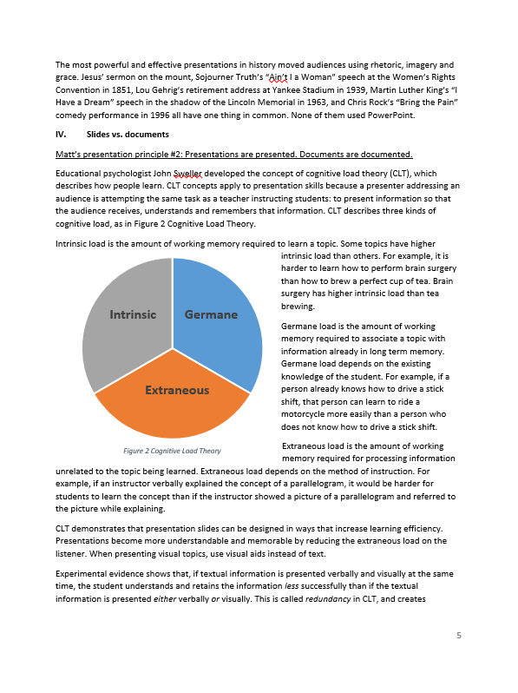
Notes:
So how can the audience access the detailed information spoken but not documented in the slides? In his book Presentation Zen, Garr Reynolds recommends preparing a separate handout document, written in words, sentences and paragraphs, that includes all the detailed information, analysis and exposition that used to be cluttering up your slides. In PowerPoint, this detailed information can be written in the Notes field. When the presentation is printed in Notes Page View, it produces a handout document with sentences and paragraphs, supplemented with the slides as visual aids. When presented as a Slide Show, it shows the slides as intended, clutter-free and visually engaging.

Slide 27
Notes:
Why make more work for ourselves creating two work products? Because it’s the right thing to do. The engineers and managers at NASA and Boeing involved with the space shuttle Columbia mission were successful in their careers. But they made mistakes. People like James Mattis, H.R. McMaster, and other military commanders aren’t all wrong. Jeff Bezos isn’t a crackpot. People who’ve devoted their careers to studying and improving information design, educational psychology, and presentation design aren’t trying to fool you. Edward Tufte, John Sweller, and Garr Reynolds aren’t all charlatans. The fruits of their labor are readily available, the strategies, the recommendations, and the empirical data. Right there for the taking. For free!
Improvement is change.

Slide 28
Principle #3
1
2
3
4
5
Notes:
Matt’s presentation principle #3: The best way to give a good presentation is to give a good presentation.
The title of this document is “Better PowerPoint.” It’s not “Better PowerPoint without putting in any additional effort.” Good presentations take time, effort, creativity, practice. Won’t that be harder than before? Yes, but it’s not about you, it’s about them. It’s better to work harder and successfully engage, inform, and persuade a room full of people, than to work less and waste an hour of everyone’s time.

Slide 29
Tip #1
Sculpt, don’t paint
Notes:
Painters typically add paint to a canvas a little at a time until the image is created. It is an additive process. Sculptors typically carve away pieces from a block of clay until the figure inside presents itself. It is a subtractive process.

Slide 30
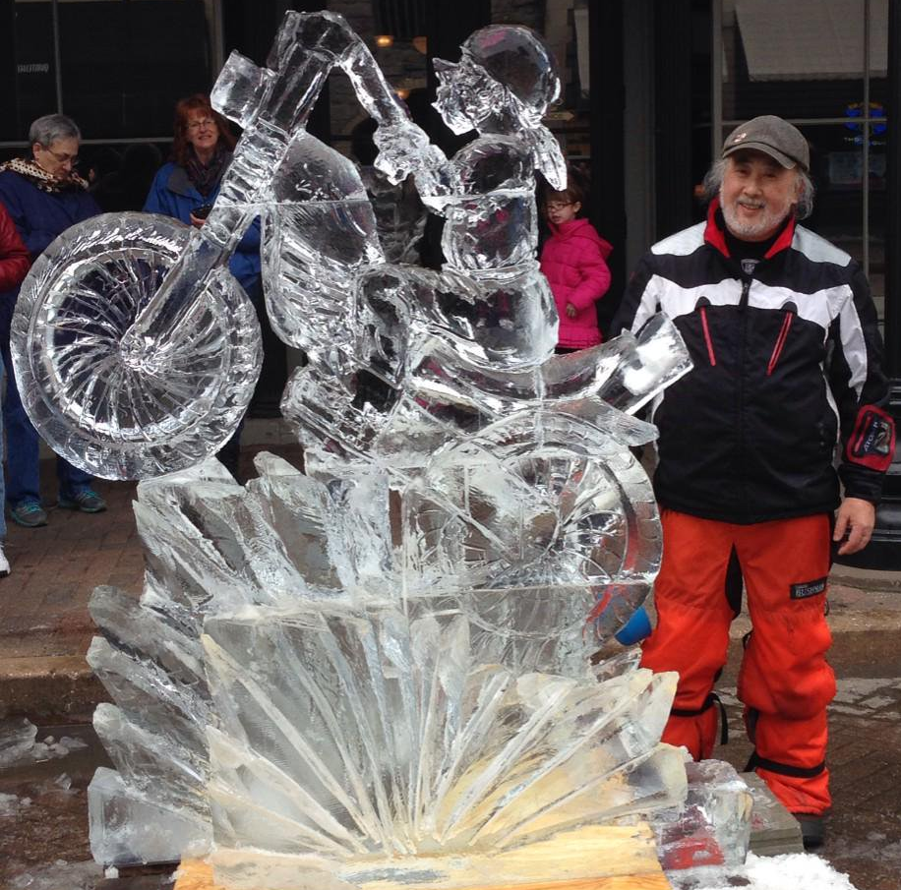
Notes:
Photo credit: J. B. Forbes. Retrieved from https://www.stltoday.com/entertainment/arts-and-theatre/hotlist/best-bets-fete-de-glace-wonder-bread-years-and-more/article_dbfefe7a-fe06-5796-abe7-6ff1f083e8f9.html

Slide 31
Notes:
Instead of thinking “what more can I fit on this slide” think “what more can I remove from this slide.” Clutter is your enemy. Parsimony is your friend. Keep your slides simple, elegant, direct. If you can’t think of a good reason to have it on the slide, carve it out. Company logos? Gone, they can stay on the title slide. Slide numbering? Gone, because, why are they there? Your presentation isn’t a book, it’s a visual aid.
Figure: credit Garr Reynolds. Retrieved from http://www.garrreynolds.com/preso-tips/design/

Slide 32
Tip #2
Obey the rule of six
Notes:
The average person “sees” quantities of six objects or less. More than six, and the person begins to “count” rather than “see.” If you must use bullet points, keep them to six or less per slide. It will reduce the extraneous cognitive load for your audience.

Slide 33
Notes:
The average person sees six items or less in about 0.5 seconds.

Slide 35
Notes:
The average person counts over seven items at a much slower rate. Recognizing the number of items without counting is called subitizing. Recall that dice have six items on the most copious side and can be subitized.

Slide 39
Tip #3
Say your name
Notes:
There is a correct way to say your name.
Say the first name, with a slight upswing in tonality on the last syllable (this is nonverbal for “I’m not finished yet”),
then pause slightly (nonverbal for “that was the first word, here comes the second word”),
then say your last name with a slight downswing in tonality on the last syllable (nonverbal for “I’m finished now.”)
This technique will help people hear and remember your name more effectively.
There’s actually a video for this! https://www.youtube.com/watch?v=02EJ1IdC6tE&t=579s

Slide 40
Tip #4
Breathe with your diaphragm
Notes:
Because your lungs are narrower at the top and wider at the bottom, a speaker can produce more air, with less effort, by constricting the bottom of the lungs. This produces a smoother, richer, more consistent speaking voice. Using the air in the top of the lungs causes the speaker to constrict the chest and neck, resulting in a higher pitch, weaker voice with vocal fry. Speech pathology research indicates that audiences associate a lower, smoother vocal tone with confidence, trustworthiness and credibility.

Slide 41
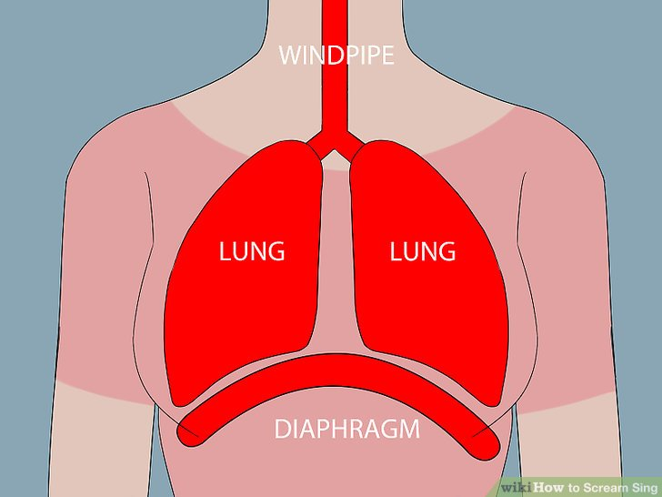
Notes:
In order to speak with air from the bottom of the lungs, speakers should practice breathing with the diaphragm. The diaphragm is a muscle that sits at the bottom of the chest cavity, and pulls down to draw air into the bottom of the lungs. Instead of pulling air into your lungs by expanding your chest, pull air into your lungs by sticking out your stomach. Then slowly pull in your stomach as you speak.
Illustration: credit wikihow.com. Retrieved from https://www.wikihow.com/Scream-Sing

Slide 42
Tip #5
Practice
Notes:
Software consultant and speaker Mark Robinson stresses the importance of practicing a presentation before delivering it to an audience. He strives to practice his talks, out loud, ten times before presenting. If possible, he practices many of those ten times at the actual location of the presentation, speaking to an empty auditorium.
If practicing the entire presentation is unfeasible, try to at least practice the opening and closing sections of the presentation out loud.

Slide 43
Tip #6
Disarm
Notes:
The custom of shaking hands comes from a tradition in ancient Greece. It symbolizes two people demonstrating to each other that they are unarmed. In the context of a presentation, speakers can subtly and subconsciously convey trustworthiness, credibility, and sincerity to an audience.
First, step out from behind the lectern. It may make you as a speaker feel safe and protected, but it’s not about you, it’s about them. Audiences respond more positively to a speaker if the lectern barrier between you is removed.
Second, show your palms when you gesture, instead of showing the backs of your hands, keeping your hands hidden in your pockets or clasped. Psychology studies show that showing your palms increases the level of trust between a speaker and audience.
See https://www.youtube.com/watch?v=ZK3jSXYBNak for body language tips from public speaking expert Dananjaya Hettiarachchi.

Slide 44
Tip #7
Go dark.

Slide 45
Don’t do this.
Notes:
The standard templates in PowerPoint use a white background with black text. During a presentation, the light shines from the projector, hits the screen, and bounces into the viewer’s eyes. It’s like shining a flashlight into someone’s eyes while they’re reading. It causes the pupils to constrict, and ever so slightly causes the reader’s blood pressure to rise.

Slide 46
Do this.
Notes:
A more visually relaxing and pleasant strategy is to use dark backgrounds with light text. The audience’s pupils dilate, and their eyes (and hearts) ever so slightly relax.

Slide 47
Tip #8
Think like Don Draper
Notes:
According to a 2013 article in Consumer Psychology, audiences process and remember information more successfully in a picture-text slide (or poster, or advertisement) if the picture is on the left and the text is on the right. This is because the right brain processes visual information more quickly, and the left brain processes textual information more quickly.

Slide 48
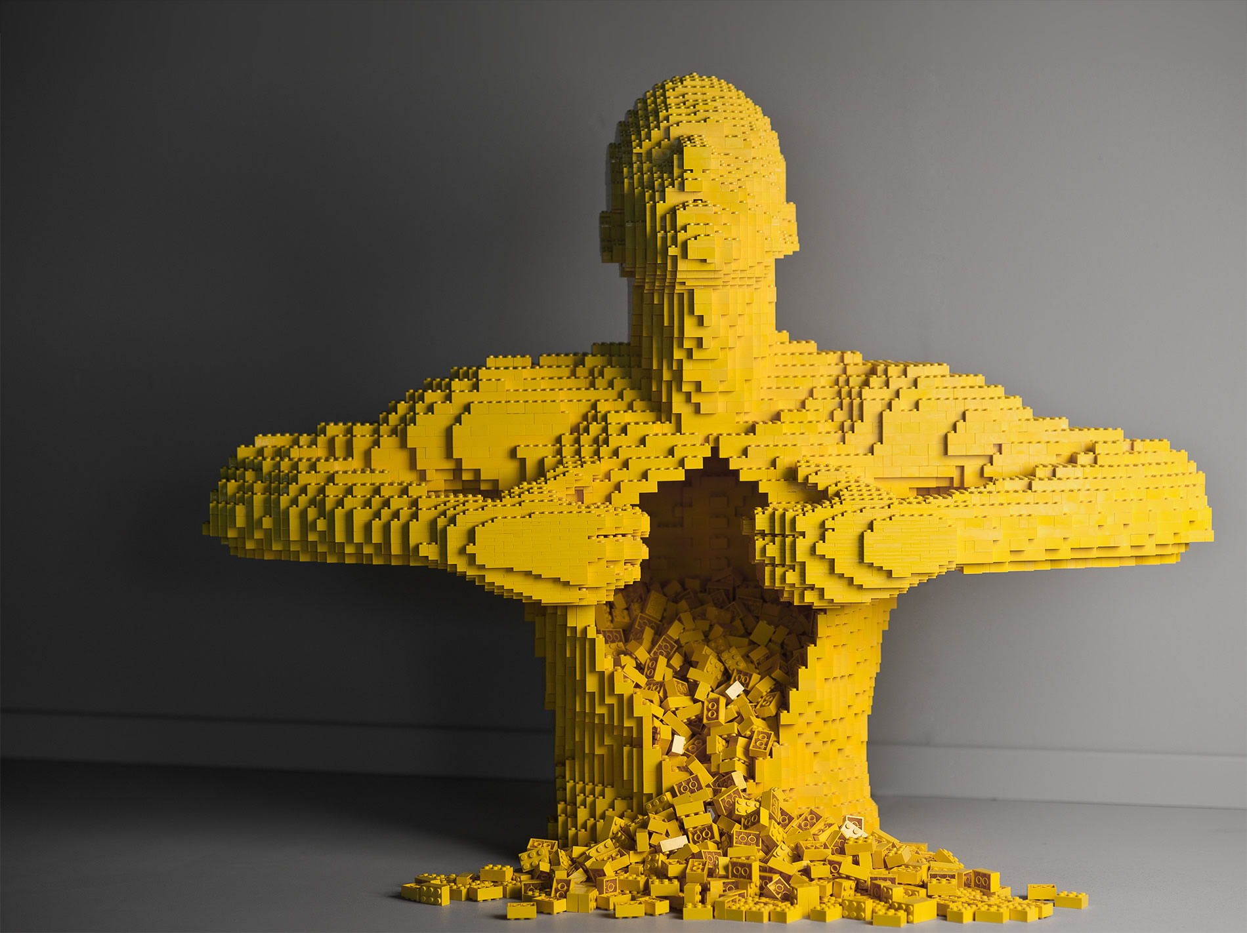
Don’t put text on the left of the picture
Notes:
Photo: credit Nathan Sawaya. Retrieved from http://www.nathansawaya.com/human-condition.html

Slide 49
Instead, put text on the right of the picture
Notes:
Photo: credit Nathan Sawaya. Retrieved from http://www.nathansawaya.com/human-condition.html

Slide 50
Tip #9
Mix it up
Notes:
Here are some simple techniques for occasionally mixing up the presentation style, in order to keep the audience engaged and attentive. Most of these come from Mark Robinson. His advice for keeping an audience’s attention can be viewed here: https://www.youtube.com/watch?v=jORl4e8pBiI

Slide 51
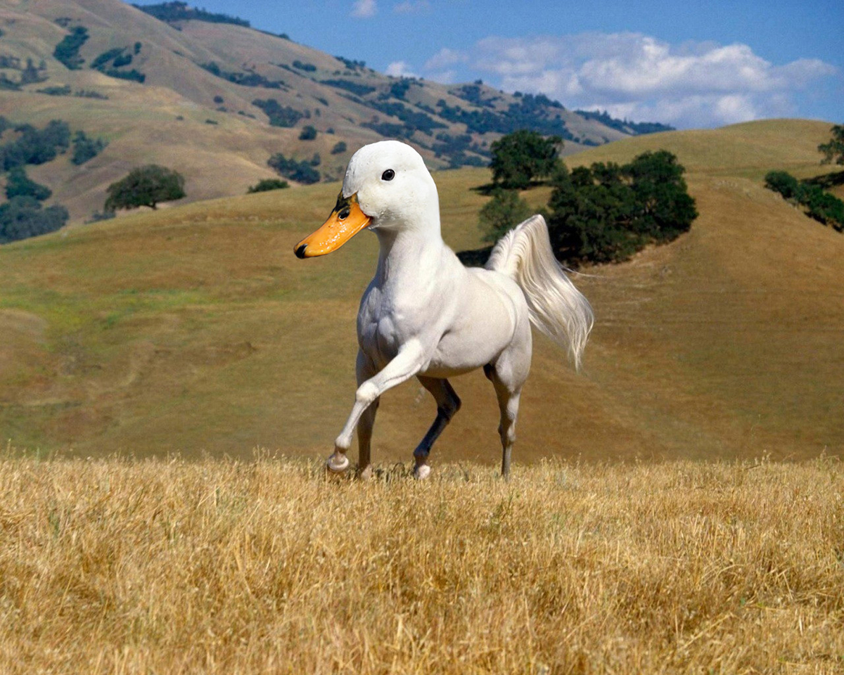
Questions
Stories
Humor
Participation
Notes:
First, ask questions. Whether you want them to answer, or you’re asking rhetorically, hearing something in the form of a question piques an audience’s interest, because they’re quietly wondering if they know the answer.
Second, tell stories. Even in a technical engineering presentation, you can relate short (30-60 second) stories about how you learned of the topic, or how you’ve seen the concept in action.
Third, use humor. Don’t be afraid to show a funny slide or make a joke, as long as it’s in some remote way related to the topic. The audience will stay focused, wondering where be your next gibe.
Finally, make your audience do something. Have someone stand up for some reason. Say “raise your hand if you’ve ever done this.”
Photo: credit Ron Kimball. Retrieved from https://www.gyyporama.com/

Slide 52
Tip #10
Go darker
Notes:
While in the “Slide Show” mode in PowerPoint, if you click the letter “b” on the projector-connected computer’s keyboard, it will blank the projector. Think of the “b” as standing for “blank” or “black.” Feel free to use this feature. You don’t always need the picture or text showing on the wall. Let them see the slide, absorb its content, then blank it out and speak your point. Then click “b” again to toggle the slide back on, and proceed to the next topic.

Slide 53
1
2
3
4
5
Conclusion
Notes:
The concepts, techniques and suggestions in this document are borrowed from experts. Don’t use PowerPoint unless it’s necessary. Separate the presentation from the document. And make your presentation good through hard work.
By implementing these ideas, a little at a time or all at once, you will set yourself apart as an expert communicator and presenter.

Slide 54
Tip #11
Make them applaud
Notes:
Mark Robinson’s technique for tricking your audience into applauding at the end of your presentation: https://www.youtube.com/watch?v=jORl4e8pBiI
Verbally indicate that you’re finished. “Thank you for listening.”
Physically indicate that you’re finished. While saying “thank you,” take a very small bow.
Prime them to clap. After saying “thank you” make one small, quiet clap.
Take a small step backwards. This subconsciously creates a vacuum between you and the audience that they will feel compelled to fill with applause.

